Slide 1

Check Sheet
A convenient and compact format for data collection
A Simple rule– Maximum information with minimum writing efforts and easy to fill
Feroze1888 Mills Limited

Slide 2
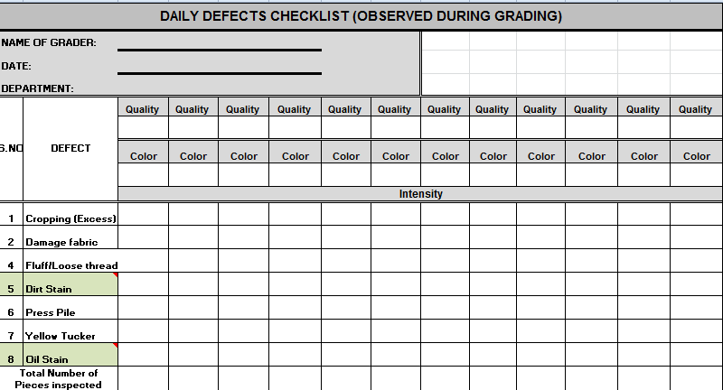
Check Sheet
Feroze1888 Mills Limited

Slide 3
Graphs & Charts
Graphs represent data pictorially. A picture can see what 1000 words can not tell.
We have different types of charts, few common types are given below.
Line Chart
Bar Chart
Multiple bar chart
Pie Chart
Gantt chart etc..
Feroze1888 Mills Limited

Slide 4
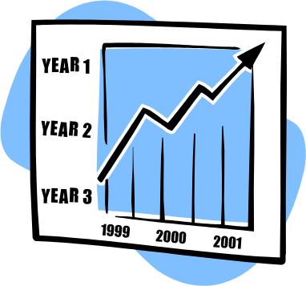


Graphs & Charts
Line Graph
Line graphs manifest the overall trend in time series data by direction of their lines.
Bar chart
Bar graphs are parallel bars of identical width but differing length to compare size of different quantities / things.
Pie Chart
Pie charts makes it easy to grasp the breakdown of the components of a quantity over a certain period.
Feroze1888 Mills Limited

Slide 5
Graphs & Charts
Multiple Bar Chart
Used for the comparison purpose. Like to compare the production of Machine A & B
Component Bar Chart
Used for comparison as well as to show contribution
Feroze1888 Mills Limited

Slide 6
Graphs & Charts
Gantt Chart
Gantt Charts makes it easy to understand the details of a plan and progress in its implementation schedule.
Type of work | 1 | 2 | 3 | 4 | 5 | 6 | 7 | 8 | 9 | 10 | 11 | 12
Foundation work Frame work Dry-walling Exterior touch up Sheetrock work Plumbing Electrical wiring Fit Fixtures Paint interior wall Interior touch up Inspection delivery
Feroze1888 Mills Limited

Slide 7
Pareto Diagram
80% of problems are caused by less than 20% of probable causes.
Establishes proof of the need.
Identifies vital few.
Feroze1888 Mills Limited

Slide 8
Pareto Diagram
Example: Personal Expense
Head | Expense | Ratio to total | Comm. Frequency
Eidi | 4500 | 28.3% | 28.3%
Dress | 4000 | 25.2% | 53.5%
Perfume | 4000 | 25.2% | 78.6%
Shoes | 2400 | 15.1% | 93.7%
Others | 1000 | 6.3% | 100.0%
Total | 15900
Feroze1888 Mills Limited

Slide 9
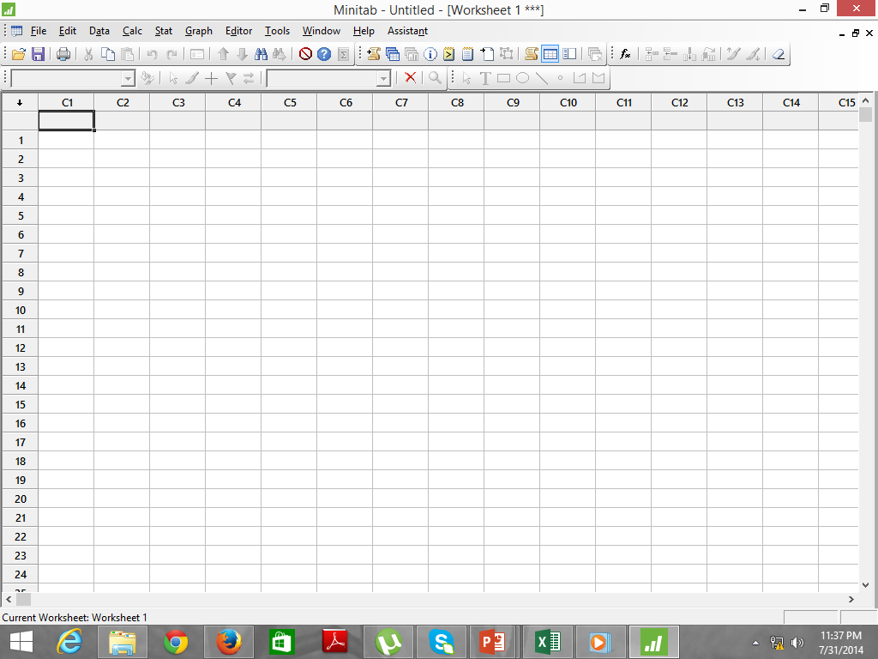
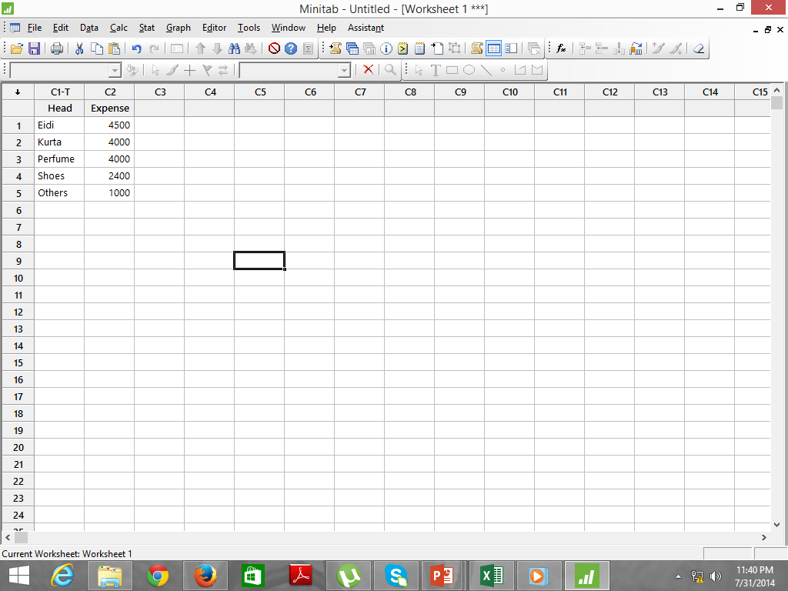
Head | Expense | Ratio to total | Comm. Frequency
Eidi | 4500 | 28.3% | 28.3%
Dress | 4000 | 25.2% | 53.5%
Perfume | 4000 | 25.2% | 78.6%
Shoes | 2400 | 15.1% | 93.7%
Others | 1000 | 6.3% | 100.0%
Total | 15900
Pareto Diagram
Solution by Minitab: Step by Step
Step 1 : Open Minitab
Step 2 : Enter Data
Feroze1888 Mills Limited

Slide 10
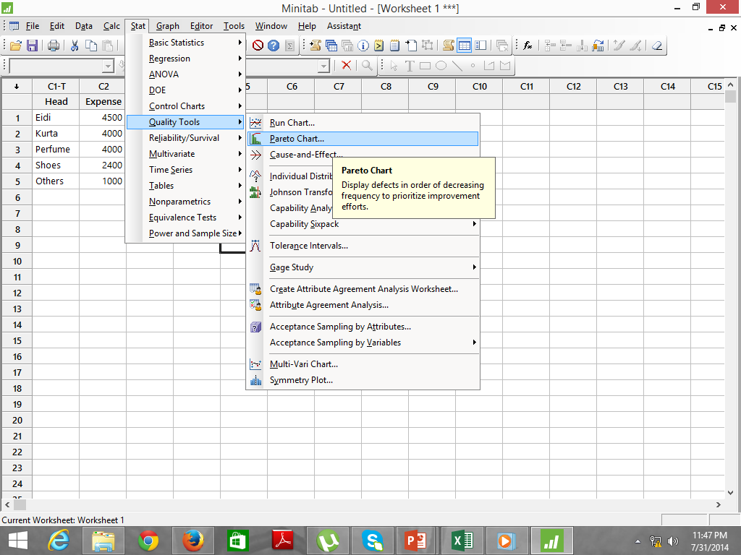
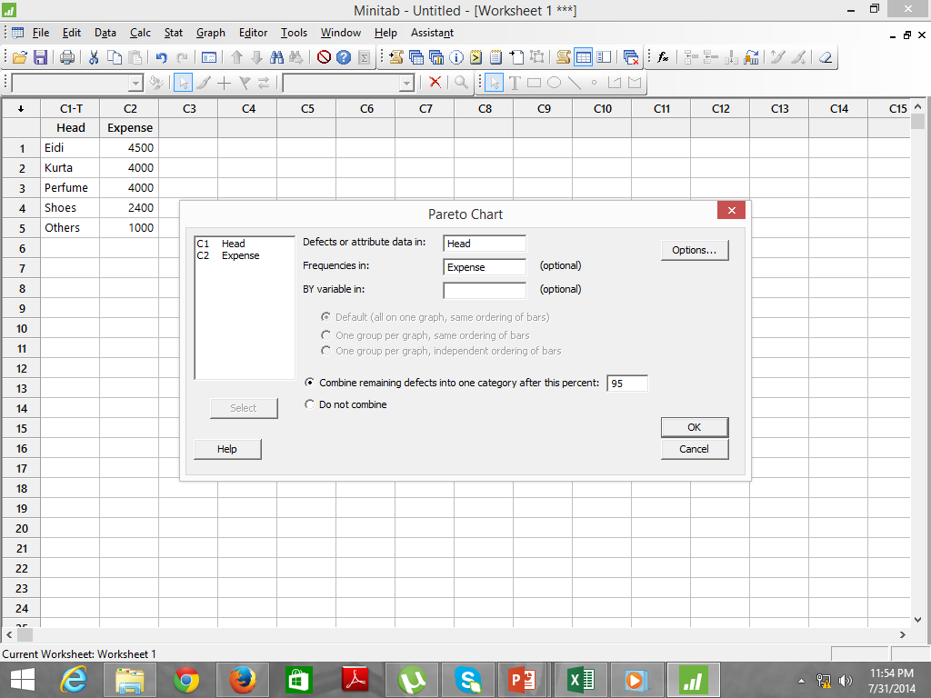
Head | Expense | Ratio to total | Comm. Frequency
Eidi | 4500 | 28.3% | 28.3%
Dress | 4000 | 25.2% | 53.5%
Perfume | 4000 | 25.2% | 78.6%
Shoes | 2400 | 15.1% | 93.7%
Others | 1000 | 6.3% | 100.0%
Total | 15900
Pareto Diagram
Solution by Minitab: Step by Step
Step 3 : Go to Stat Menu > Quality Tools > Pareto Chart
Step 4 : A window will appear to select data
Feroze1888 Mills Limited

Slide 11
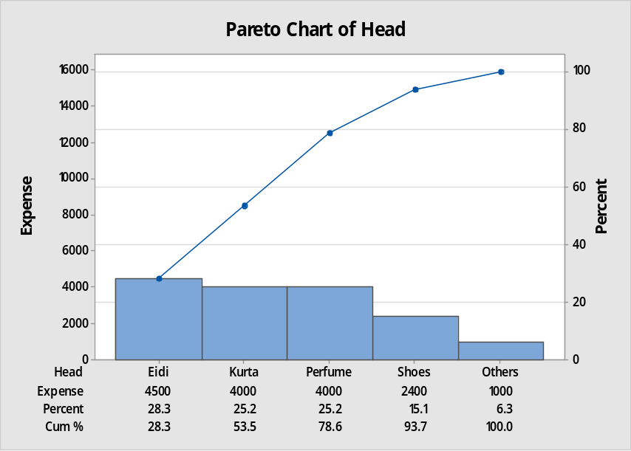
Head | Expense | Ratio to total | Comm. Frequency
Eidi | 4500 | 28.3% | 28.3%
Dress | 4000 | 25.2% | 53.5%
Perfume | 4000 | 25.2% | 78.6%
Shoes | 2400 | 15.1% | 93.7%
Others | 1000 | 6.3% | 100.0%
Total | 15900
Pareto Diagram
Solution by Minitab: Step by Step
Step 5 : A Pareto Chart will appear
Step 6 : Analyse the Chart
Feroze1888 Mills Limited

Slide 12
Cause & Effect Diagram
Graphic tool to represent relationship between an effect and influencing causes.
There can not be an effect without a cause.
Reduce incidence of subjective decision making.
Identify main causes X’s influencing Y.
For each of the X’s identified in the fishbone diagram classify them as follows:
Controllable – C (Knowledge)
Procedural – P (People, Systems)
Noise – N (External or Uncontrollable)
First produced in 1950 by Professor Kaoru Ishikawa - Also called the:
  Ishikawa Diagram
  Fish Bone Diagram
Feroze1888 Mills Limited

Slide 13
Construction of C&E Diagram
Define problem
Gather members for discussion
Conduct Brainstorming
Group causes into 6M’s for Product and 4P’s and 2M’s for the Services
For each cause, ask, “What goes wrong that produces the effect”.
Identify major causes
Services: 5M’s & 1E
People
Policy
Procedure
Place
Measurement
Mother-nature
Product: 6M’s
Man
Machine
Material
Method
Mother-nature
Measurement
Feroze1888 Mills Limited

Slide 14
Cause & Effect Diagram
Measurements Materials Manpower
Failure Mode
(Defect)
Failure
Effect
Mother Methods Machines
Nature
Feroze1888 Mills Limited

Slide 15
Example 1: C &E Diagram (Defects)
Measurement
Manpower
Material
Reproducibility
Repeatability
Inadequate
training
Late
Linearity
Wrong quantity
Stability
Lack of
experience
Calibration
Defective
Distractions
Defects
Too hot
Vague
Too humid
Out of date
Not maintained
Too cold
Inadequate capability
Complex
Mother nature
Machines
Methods
Feroze1888 Mills Limited

Slide 16
Activity#3
Your car is consuming a lot of Petrol. In a group of two, construct a fish bone diagram to capture all possible causes for this nausea .
Feroze1888 Mills Limited

Slide 17
Activity 3: C &E Diagram
Procedure
Driver
Vehicle
Impatience
Heavy
Spark plugs
Poor
anticipation
Bad
attitude
Contacts
Craze
Life
Body
Technical
details
Wrong
gears
Poor
skill
Shape
Always
late
Fuel mix
Lack of
awareness
Inexperience
High H.P
Carburetor
Wrong
culture
Riding on
clutch
Engine
Cylinders
High Petrol
Consumption
Crossings
Spurious
Restrictions
Spares
Impurities
Traffic
Incorrect
Octane no.
One way
No turn
Tyres
Inferior
Frequent
stops
Faulty
pressure
Petrol
Circuitous
Road
Negligence
Speed Breakers
Ignorance
Additives
Potholes
Irregular
servicing
Low pressure
Incorrect viscosity
Poor
condition
Clogged
filters
Oil
False
economy
Steep
Not changed
Road
Maintenance
Materials
Low level
Feroze1888 Mills Limited

Slide 18
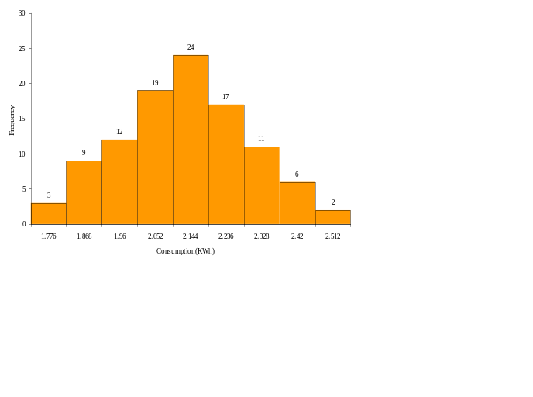
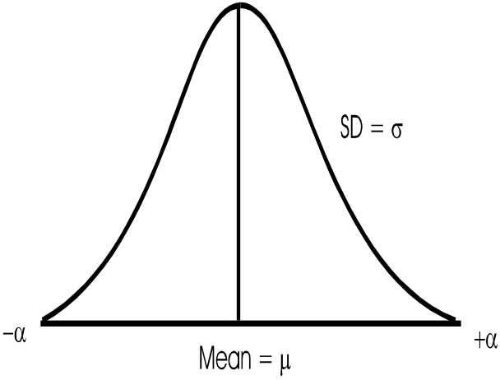
Histogram
A Histogram is a bar graph that shows frequency data.
Histograms provide the easiest way to evaluate the distribution process.
Histogram is characterized by 3 Constituents:
Center ( mean)
Width (spread-variation)
Over all shape
Feroze1888 Mills Limited

Slide 19
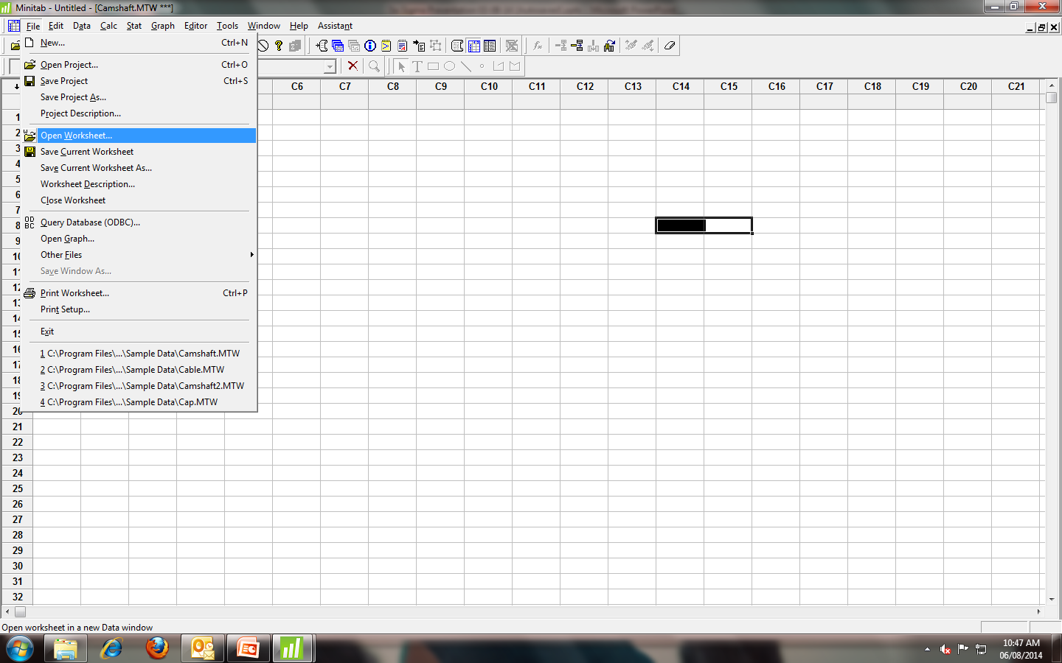
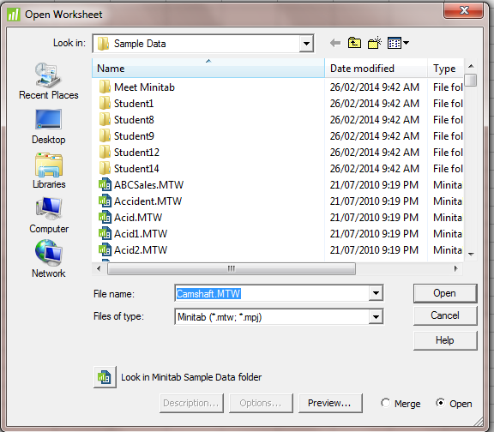
Exercise: Histogram
Plot the histogram of Supplier 1 from the data given in camshaft. Mtw.
Step 1 : File > Open Worksheet > camshaft. mtw
Feroze1888 Mills Limited

Slide 20
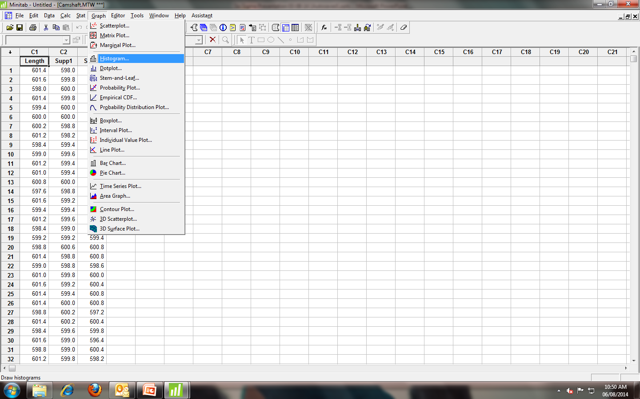
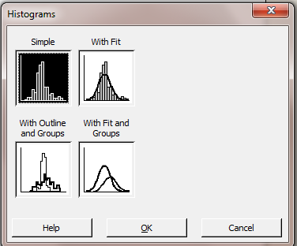
Histogram
Step 2 : Graph > Histogram > Simple
Feroze1888 Mills Limited

Slide 21
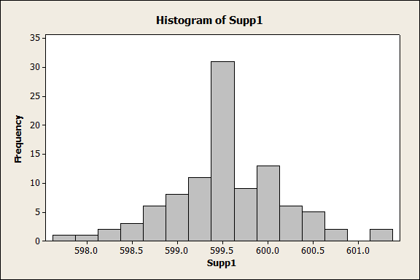
Histogram
Feroze1888 Mills Limited

Slide 22
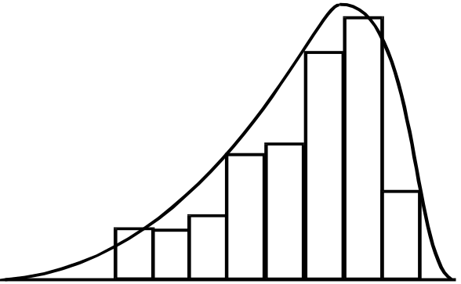
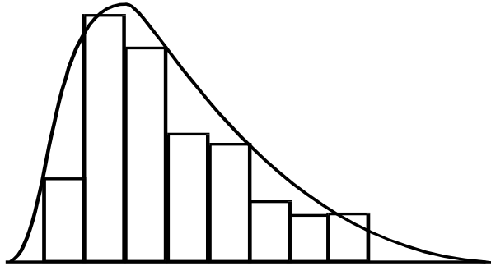
Types of Histogram
Bell Shaped
Symmetrical shape with a peak in middle representing a normal histogram.
Skewed to Left
Caused by centering the process toward high end of the tolerance.
Skewed to Right
Caused by centering the process toward low end of the tolerance.
Feroze1888 Mills Limited

Slide 23
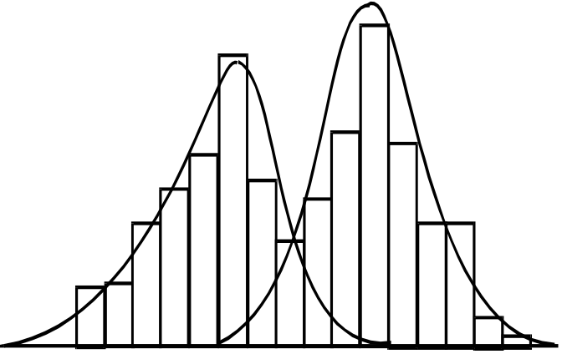
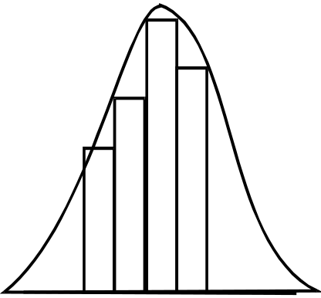
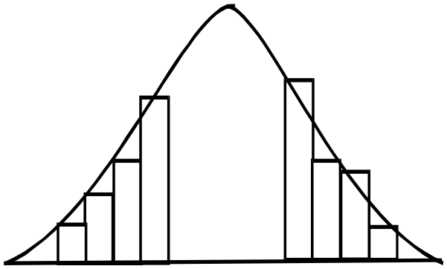
Types of Histogram
Bimodal
Two combined populations-- two shifts, operators, inspectors, suppliers, machine settings, gages, tools, machines, measurement locations, etc.
Truncated
This can happen when a process is not capable of meeting the specifications, parts are sorted from both ends, or too few classes are chosen.
Missing Centre
Centre of the distribution has been sorted from the rest. Portion may have been delivered to a customer with tighter specifications.
Feroze1888 Mills Limited

Slide 24
Histogram in Process Behavior
It tells whether process is under control?
Is it producing defect free output?
LSL
USL
LSL
USL
process variability
Feroze1888 Mills Limited

Slide 25
Histogram in Process Behavior
Shape close to normal curve
Mean at target value
Spread within Specification limits
Cp is greater than 1.67 and Cpk is greater than 1.33
Feroze1888 Mills Limited

Slide 26
Scatter Diagram
What: To study the possible relationship between two variables.
Why: Diagram make it clear whether a relationship exists, and shows the strength of relationship.
When: To test a theory that the 2 variables are related.
Feroze1888 Mills Limited

Slide 27
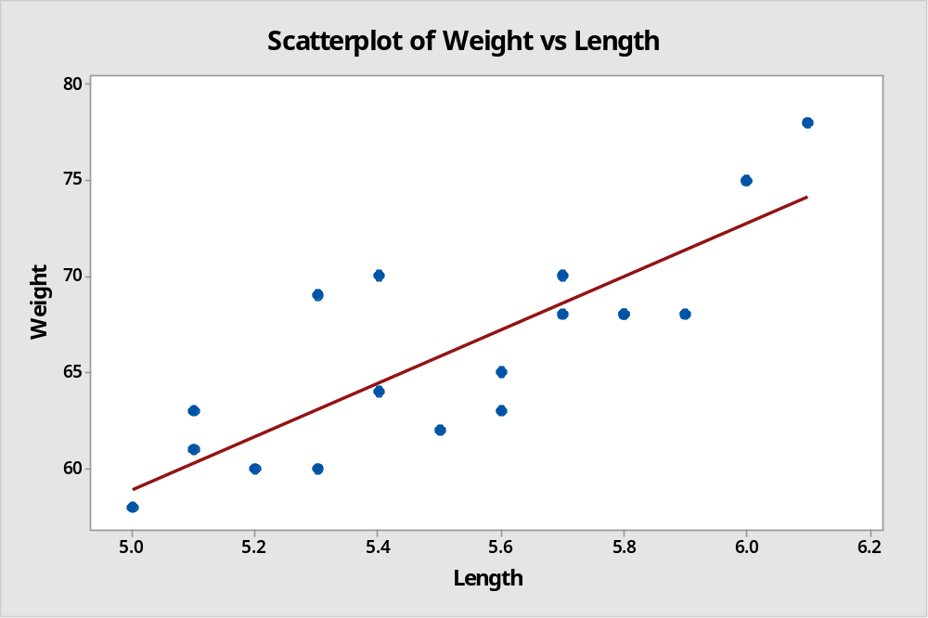
Example: Scatter Diagram
Length | Weight
5.5 | 62
5 | 58
5.2 | 60
5.8 | 68
5.7 | 70
5.6 | 63
5.1 | 61
5.1 | 63
5.4 | 70
6 | 75
5.9 | 68
6.1 | 78
5.3 | 60
5.6 | 65
5.7 | 68
5.8 | 68
5.4 | 64
6 | 75
5.3 | 69
Feroze1888 Mills Limited

Slide 28
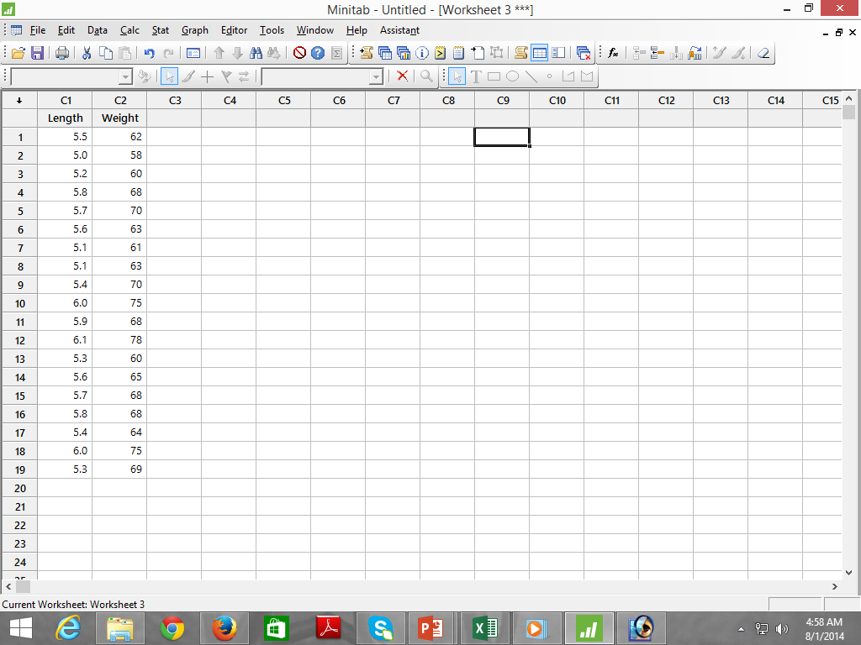
Scatter Diagram
Solution by Minitab: Step by Step
Step 1 : Open Minitab
Step 2 : Enter Data
Feroze1888 Mills Limited

Slide 29
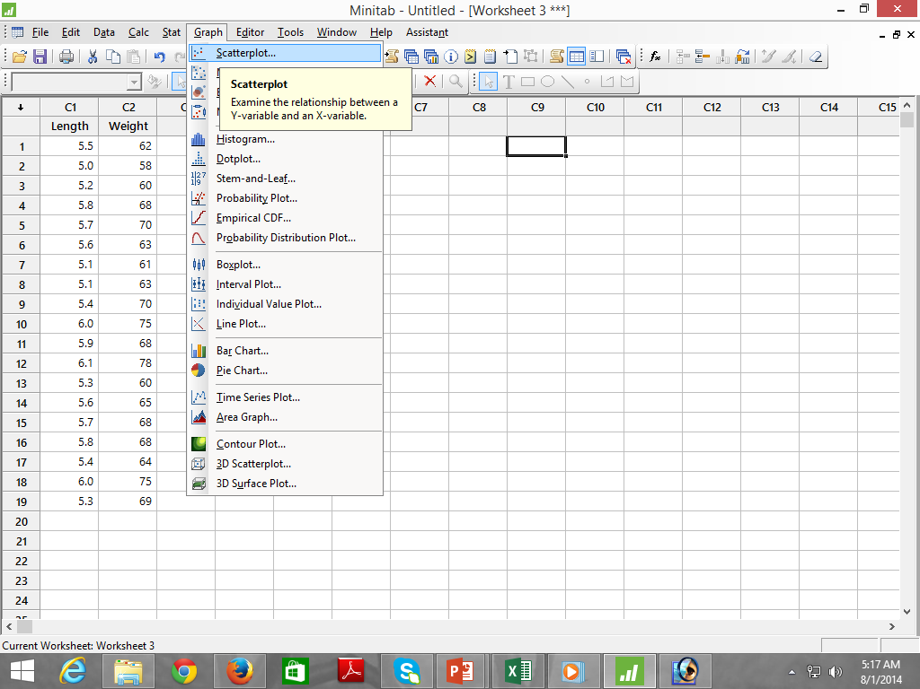
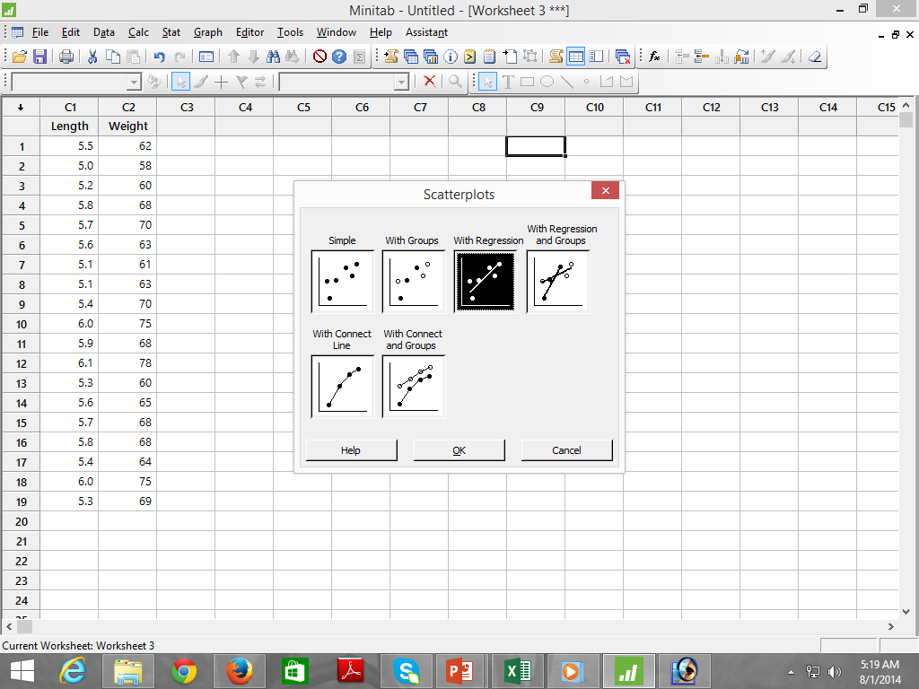
Scatter Diagram
Solution by Minitab: Step by Step
Step 3 : Select Graph > Scatter Plot
Step 4 : Select With Regression
Feroze1888 Mills Limited

Slide 30
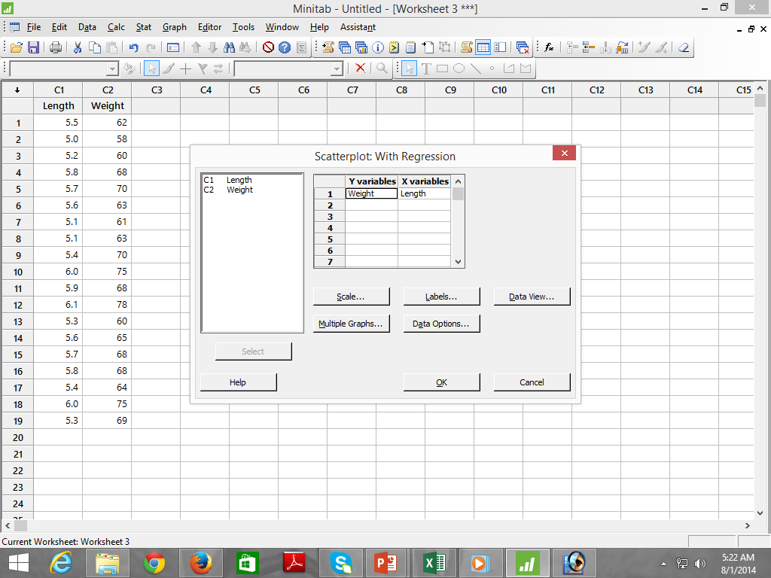
Scatter Diagram
Solution by Minitab: Step by Step
Step 5 : Choose X and Y Variables
Scatter Plot
Feroze1888 Mills Limited

Slide 31
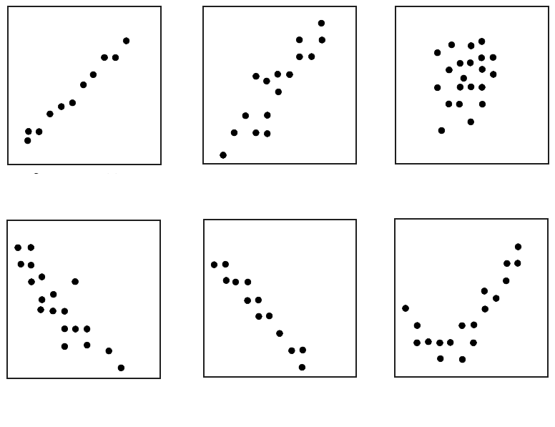
Interpretation of Plots
Strong Positive
Weak Positive
None
Strong Negative
Weak Negative
Curvilinear
Feroze1888 Mills Limited

Slide 32
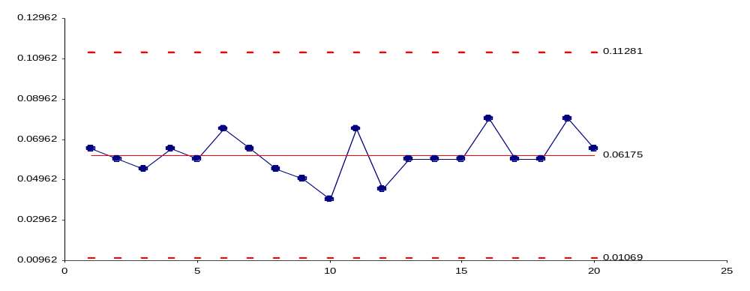
Control Chart
The control chart is a graph used to study how a process changes over time. Data are plotted in time order.
A control chart always has a central line for the average, an upper line for the upper control limit and a lower line for the lower control limit.
Lines are determined from historical data. By comparing current data to these lines, you can draw conclusions about whether the process variation is consistent (in control) or is unpredictable (out of control, affected by special causes of variation).
Feroze1888 Mills Limited

Slide 33
When to use Control Chart?
  Controlling ongoing processes by finding and correcting problems as they occur.
  Predicting the expected range of outcomes from a process.
  Determining whether a process is stable (in statistical control).
  Analyzing patterns of process variation from special causes (non-routine events) or common causes (built into the process).
  Determining whether the quality improvement project should aim to prevent specific problems or to make fundamental changes to the process.
Feroze1888 Mills Limited

Slide 34
Important Terminologies
Common Causes of Variation
Consists of combined effect of several sources of uncontrollable variation inherent to a process.
Special Causes of Variation
Determination of source of impact makes cause "assignable." and is termed as assignable cause of variation.
Specification Limit
Limits defined by the customer. Voice of customer
Control Limit
Measures the variation of sample statistics by using data points.
Feroze1888 Mills Limited

Slide 35
Common & Special Causes
Special Cause
UCL
CL
Common Cause
LCL
Special Cause
Feroze1888 Mills Limited

